Slide 1
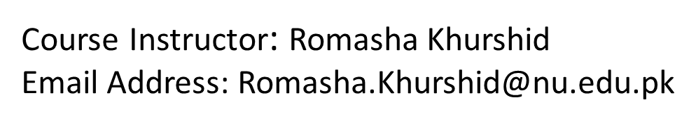
Reference Book: Applying UML and Patterns (An introduction to Object-Oriented Analysis and Design And Iterative Development) BY Craig Larman Third Edition
Software Design And Analysis(CS:3004)

Slide 2

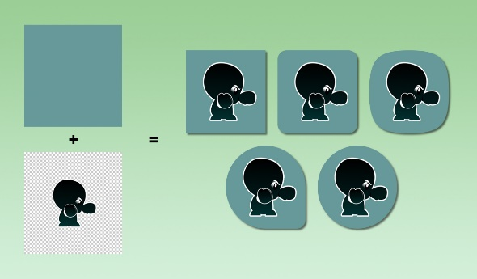
Plan-Driven and Agile Processes:
Plan-driven processes are processes where all of the process activities are planned in advance and progress is measured against this plan.
In agile processes, planning is incremental and it is easier to change the process to reflect changing customer requirements.
In practice, most practical processes include elements of both plan-driven and agile approaches.
There are no right or wrong software processes.
Predictive
Adaptive

Slide 3
Software process models

Slide 4
Software process models
The waterfall model
Incremental development
Spiral model

Slide 5
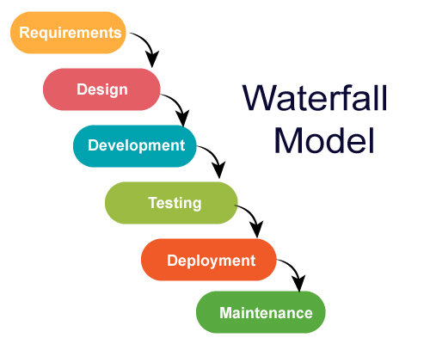
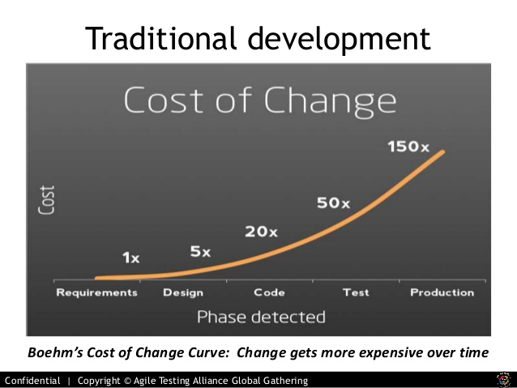
Waterfall (Traditional Approach)
Assumptions:
Requirements are very well understood.
Team has experience building similar projects (like ATM Machine).

Slide 6

Waterfall Model (Traditional Approach)
Pros:
Easy to understand and simple
Predictable
Efficient
Cons:
Not flexible for change
First release take a long time
A phase has to be complete before next phase (no back track)
Use:
Repeated Project
For Predictable project

Slide 7
Incremental development
Incremental Approach
Plan-driven
Increments identified in advance
Agile
Early increments are identified and later will be decided on customer priorities.

Slide 8
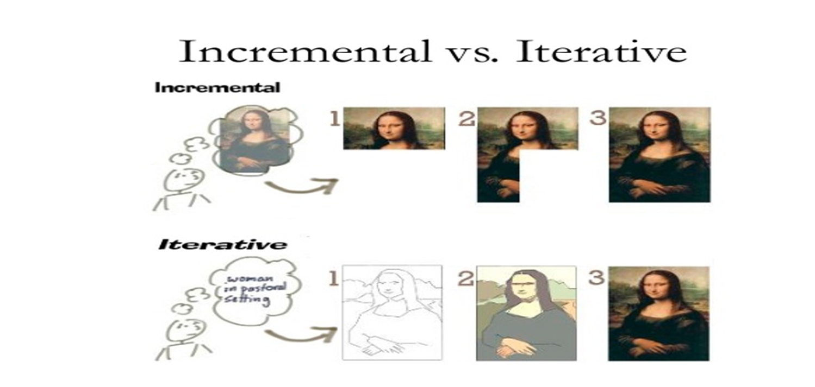

Slide 9
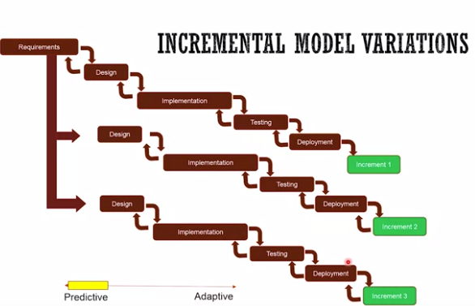
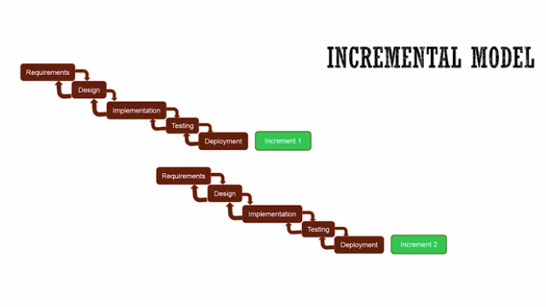
Plan-driven
Increments identified in advance
Agile
Early increments are identified and later will be decided on customer priorities.

Slide 10
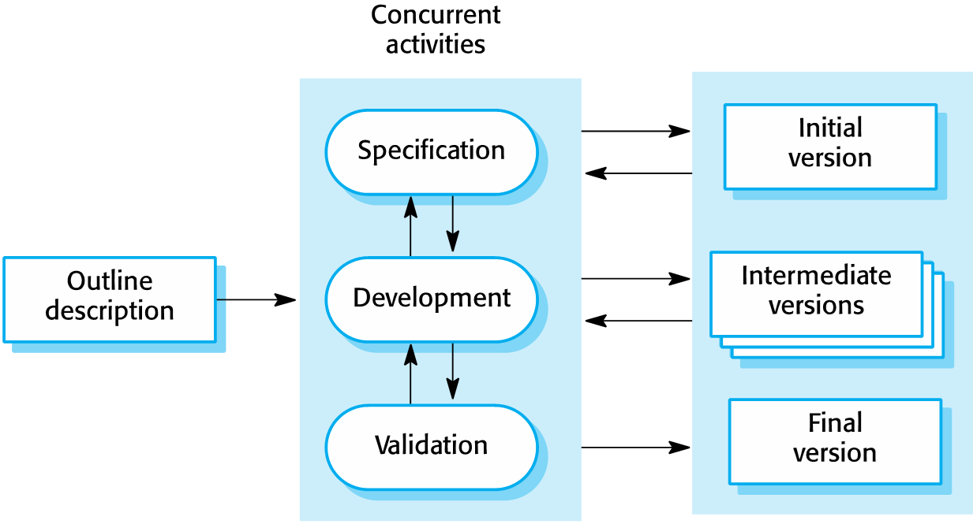
Incremental development

Slide 11
Incremental development benefits
The cost of accommodating changing customer requirements is reduced.
It is easier to get customer feedback on the development work that has been done.
More rapid delivery and deployment of useful software to the customer is possible.

Slide 12
Incremental development problems
The process is not visible.
Managers need regular deliverables to measure progress. If systems are developed quickly, it is not cost-effective to produce documents that reflect every version of the system.
System structure tends to degrade as new increments are added.
regular change tends to corrupt its structure. Incorporating further software changes becomes increasingly difficult and costly. regularly refactor the software is suggested

Slide 13
Example 01: Analyze the situation and suggest the Model
Let's say there is a solution company that basically experts in installing particular HR management system in big retailers.
So let's say company X needs to install a well known HR management system at a big retailer's headquarter. And they have done this install many times with similar retailers, big retailers before. So the question is, what model will fit best in this situation?
Well known problem
Well known solution
Waterfall Model

Slide 14
Example 02
A hospital wanted to automate their processes. And so they have hired a company that is expert in this area and has done similar automation for hospitals but not at this scale, So they have done it, but not at this scale. And then hospital management also wants consistency across the globe. So they want their processes to be consistent across the globe, but of course, every country has their own culture. And so they know that they'll be some new answers in different parts of the world, so they want to customize it over different places. And then they also realize that some of the places will greatly benefit from immediately deploying this kind of automation.

Slide 15
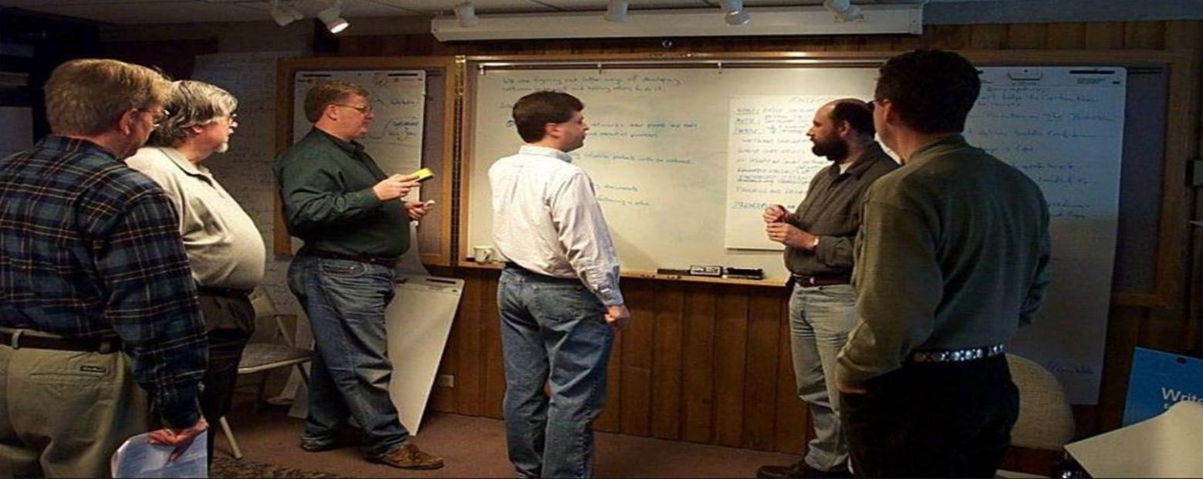
Agile Mindset:
And agile was born … 2001

Slide 16
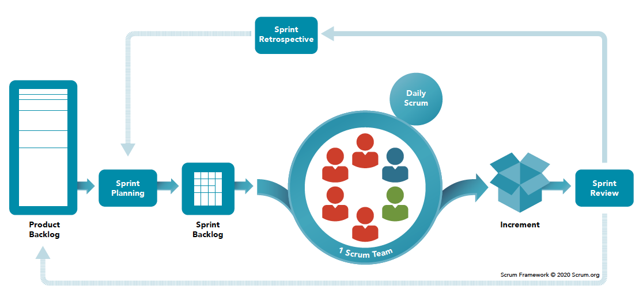
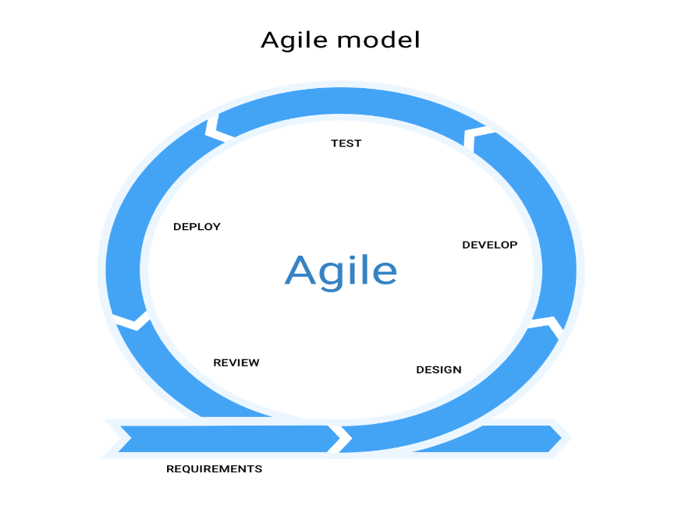
Scrum:

Slide 17
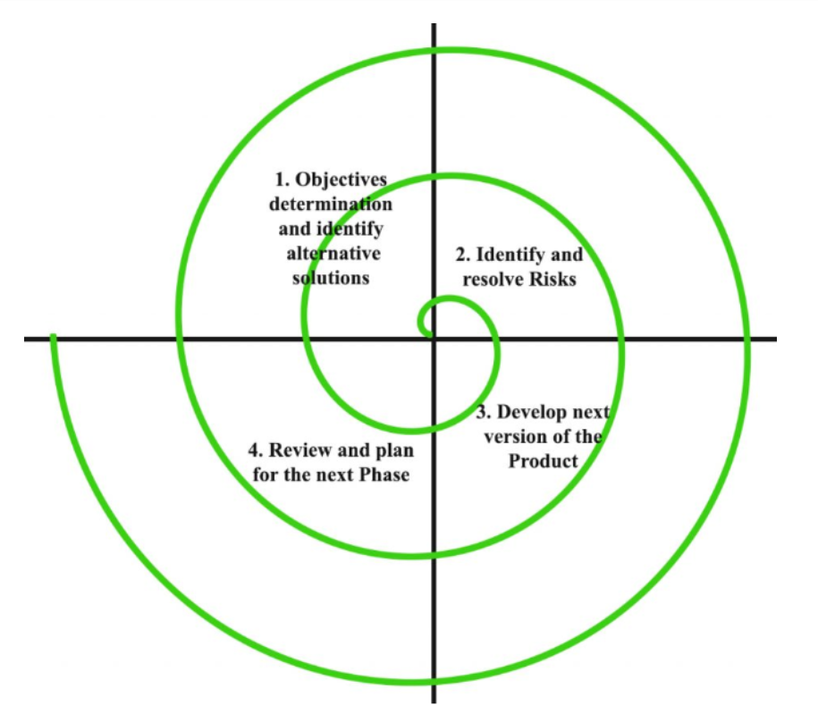
Spiral model:
Risk handling
Radius of Spiral=Cost
Angular dimension=Progress
Advantages:
Risk Handling
Large Project
Flexible
Customer Satisfaction
Disadvantages:
Complex
Expensive

Slide 18
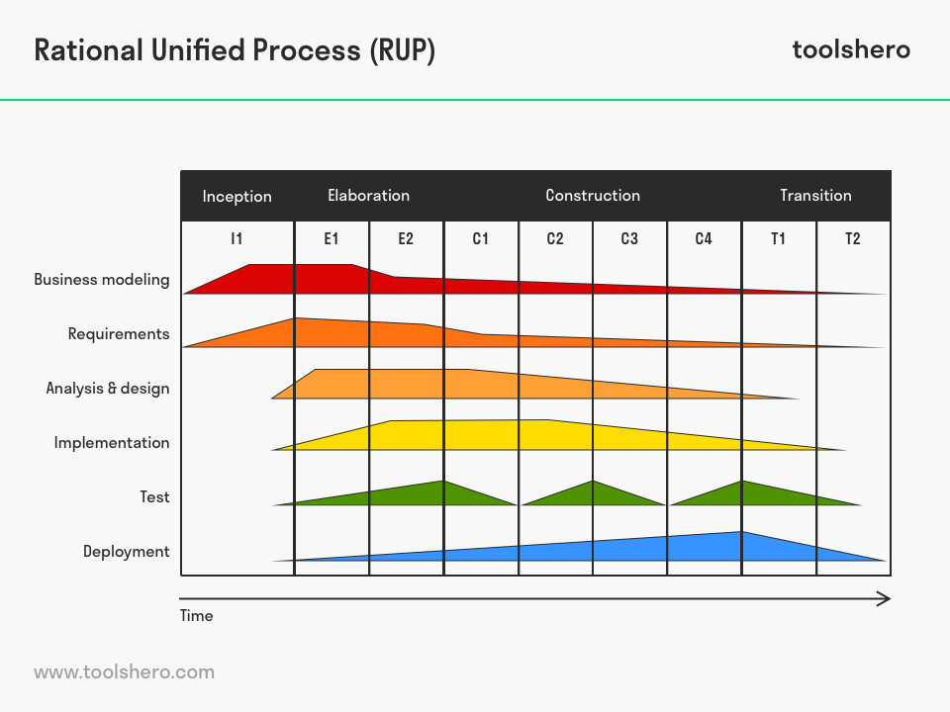

Unified Process:
It is an iterative approach
UP encourages risk-driven and client-driven iterative planning.
Phases and disciplines.

Slide 19
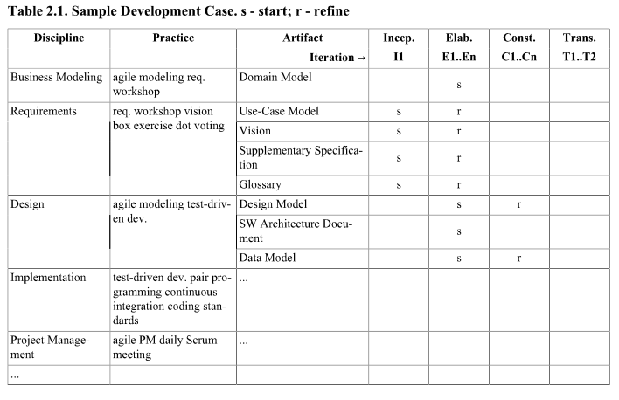
Development Case:

Slide 20

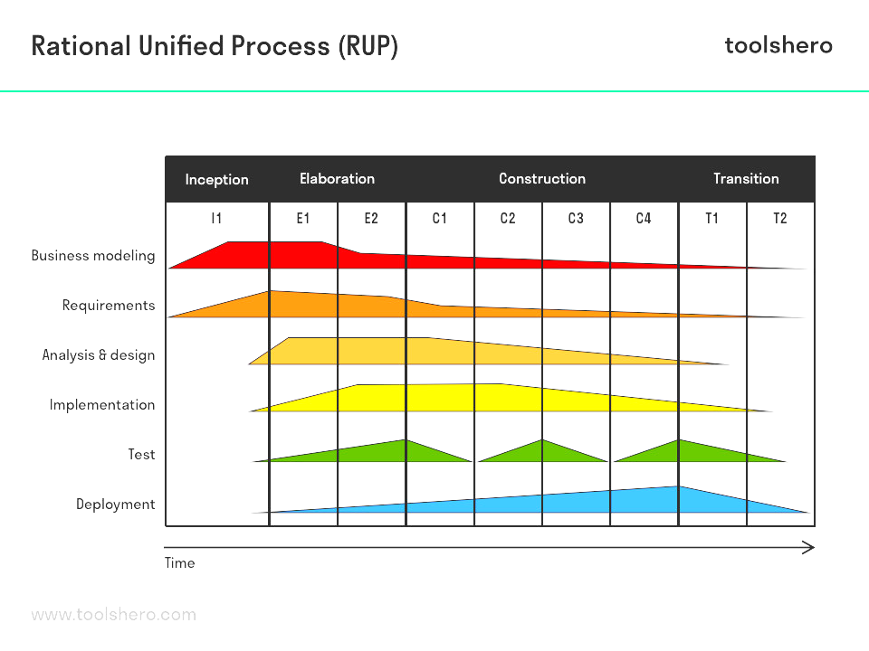

Unified Process:
Inception:
What is the vision and business case for this project?
Feasible?
Buy or build?
Rough estimates of cost and time?
Artifacts:
Business Case or Vision Artifacts
High-level Use-Case diagram

Slide 21
Unified Process:
Elaboration:
Requirements Specification
Validate Architecture
Establish Executable Architecture
Figure out risks
Artifacts:
Domain Model
Descriptive Use-Cases

Slide 22
Unified Process:
Construction: (Release)
Largest phase
Software construction
Iterative and incremental

Slide 23
Unified Process:
Transition: (Final Production Release)
Deployment
Stakeholder Feedback
User Training

Slide 24
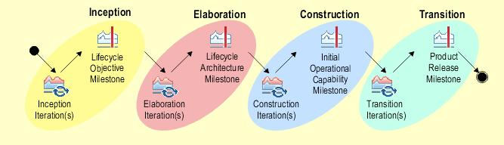
Characteristics:
It is a framework
Architecture Centric
User centric
Focus on risk mitigation

Slide 25

Predictive or Adaptive?

Slide 26

Unified Process:
Pros:
Adaptive Process
Risk mitigation
Quality
Flexible incorporate with other models.
Cons:
Complex framework
Overheads
Use:
For riskier projects
Requirements not known in early stages
Deliver value first

Slide 27
UP Artifacts:
Business Modeling: the domain model artifact
Requirements: The Use-Case model artifact
Design: The design model artifact

Slide 28
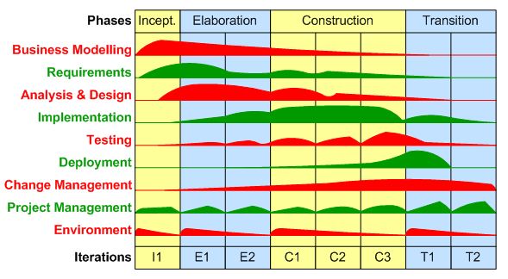
Rational unified Process: (RUP)
Most Popular Variant of UP.
RUP was evolved into AUP by Scott ambler.
4 phases, 9 key disciplines.

Slide 29
Use-Case Diagram:
Popular technique for capturing functional requirements, especially in software development..
Use case diagrams model how stakeholder interact with the system.
This type of UML diagram should be a high-level overview of the relationships between users and systems
It can be a great tool for explaining your system to a non-technical audience.

Slide 30
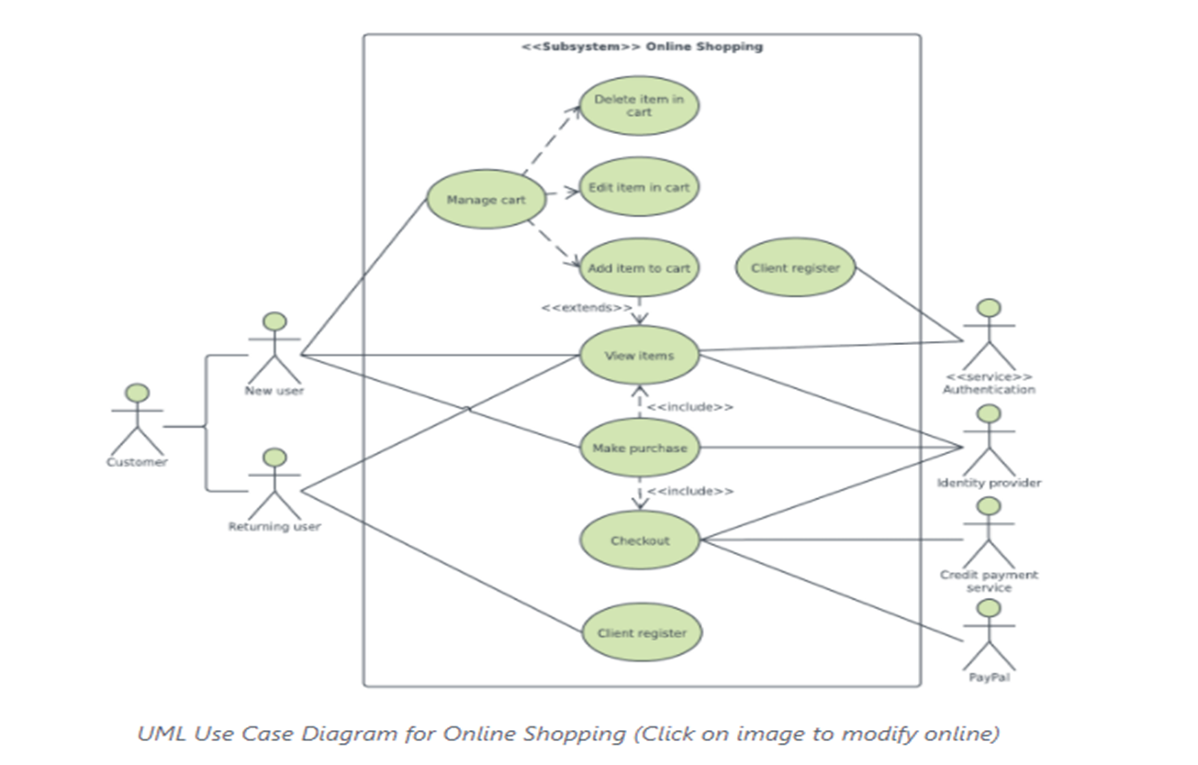
Purpose of Use Case Diagram:
Use case diagrams are typically developed in the early stage of development and people often apply use case modeling for the following purposes:
Specify the context of a system
Capture the requirements of a system
Validate systems architecture
Drive implementation and generate test cases
Developed by analysts together with domain experts

Slide 31
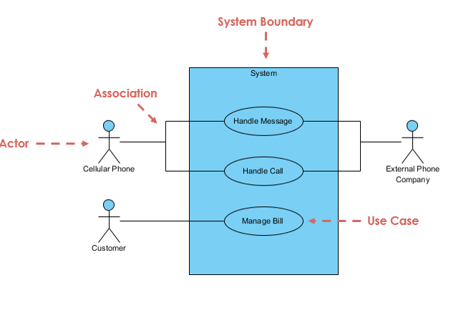
Elements of Use Case Diagram

Slide 32
1
Notation Description | Visual Representation
Actor Someone interacts with use case (system function). Named by noun. Actor plays a role in the business Actor has a responsibility toward the system (inputs), and Actor has expectations from the system (outputs).

Slide 33
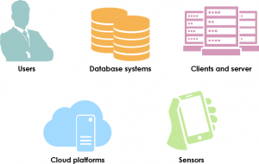

Types Of Actors:
Tips to identify actors…
Must serve as sources and destinations for data
Must be external to the system
Primary actor
has user goals fulfilled through using services of the system under discussion
drives the use cases
Supporting actor
provides a service to the system under discussion
e.g.,payment authorization service
implies: clarification of external interfaces and protocols needed.
Offstage actor
has an interest in the behavior of the use case, but is not primary or supporting
e.g., a government tax agency

Slide 34
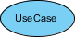
2
Use Case System function (process - automated or manual) Named by verb + Noun (or Noun Phrase). i.e. Do something Each Actor must be linked to a use case, while some use cases may not be linked to actors.

Slide 35
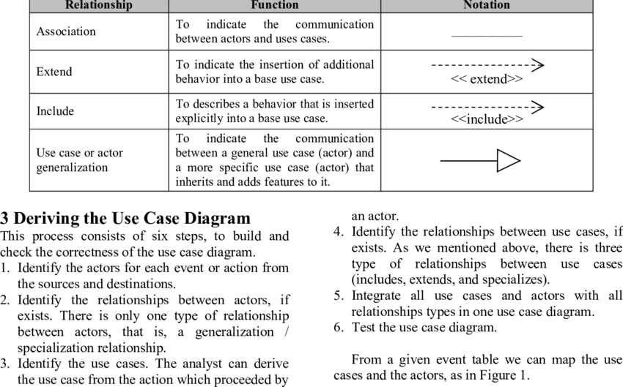
Relationship:
3
Types Of Relationship:

Slide 36
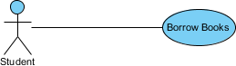
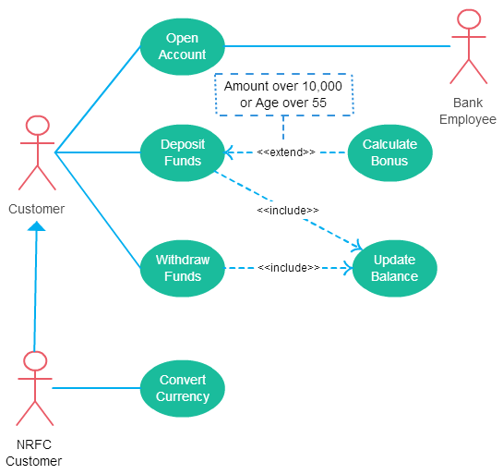
Relationships Examples…
Association Link
A Use Case diagram illustrates a set of use cases for a system, i.e. the actors and the relationships between the actors and use cases.
Include Relationship
The include relationship adds additional functionality not specified in the base use case.

Slide 37
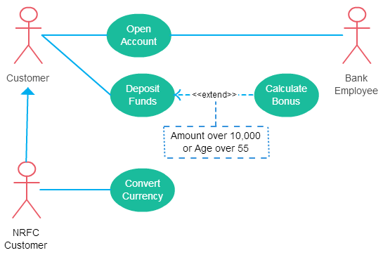
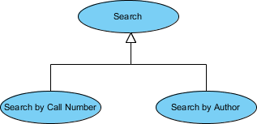
Continue….
The extend relationships are important because they show optional functionality or system behavior.
A generalization relationship means that a child use case inherits the behavior and meaning of the parent use case. The child may add or override the behavior of the parent. The figure below provides a use case example by showing two generalization connectors that connect between the three use cases.

Slide 38
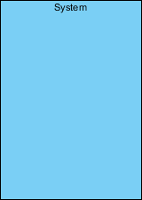
4
Boundary of system The system boundary is potentially the entire system as defined in the requirements document.

Slide 39
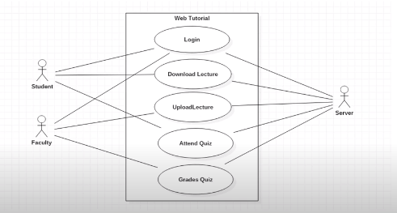
Example Use-Case

Slide 40
Continue till next week

